Slide 1
Strategy in Smart Technologies in Deutsche Telekom and T-City. Energy meets ICT.
Gabriele Riedmann de Trinidad, SVP Strategic Area Energy
International Conference „Trends in Power Industry in the European Context VII”, 18th April 2012

Slide 2
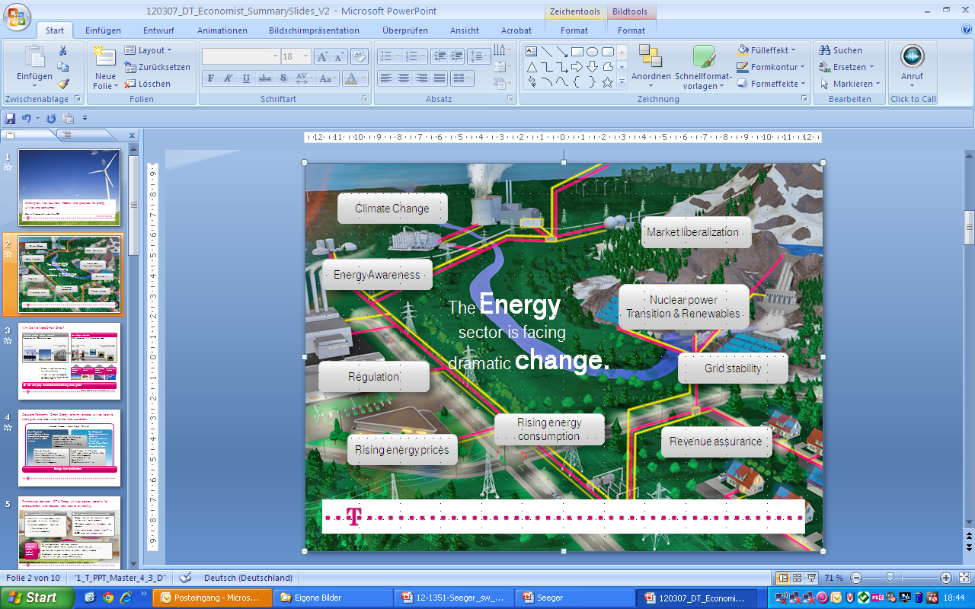



Energy Sector is facing dramatic Changes. Which are the challenges today and tomorrow?
Mass data handling
up to 35,000 data /meter/year
Customer loyality and services
Implementation of new products, tariffs models, CRM and Billing systems & increasing churn rates
Market Communication /Player Interaction Complicated customer change processes, contract changes, business process, etc
Regulation
Cost-effective compliance with increasing regulatory requirements incl. unbundling
Security and data Privacy
Security as key issue and challenge
Business Model
concentrate on core business with full cost control
Decentralized Energy Generation
Dramatic requirements on energy distribution networks with Prosumers, volatile renewables, e-mobility

Slide 3

Energy sector can leverage on ICT’s experience on end-customers loyalty and cost optimized process landscape.
Challenge Customer Loyalty
New attractive Products
  Process chain requires holistic optimization, esp. :
    Tarifing, CRM and Billing
    Cost efficient processes & IT landscape
Process Chain Optimization
  Need to constantly create attractive new products, bundles & services for end-users
Customer Loyality Measures
  Active churn management based on mass segmentation and Life-cycle management
Leverage experiences from ICT sector
  Value Added Services for End-User and proven Churn Management Programs
  Efficient and scalable end-to-end processes
  => we handle approx. 0.5 billion detailed invoices per year
  Intelligence out of the cloud, proven international standards

Slide 4

The Challenge „decentralized Energy Generation“ can significantly benefit from ICT‘s massdata handling experience.
Challenge Decentralized Generation and Storage
Massdata handling
Process optimization
  Change from few, but large central power stations to millions of prosumers
  Dramatically Changing Requirements to networks: decentralized energy generation, renewables, restorage
  Vastly increasing data volumes (from 1 to 35,000 values per customer p.a.)
  Optimization of Processes & IT-Systems according to the new requirements :
    Secure End-to-End Processes (incl. Comms)
    Reliable, secure communication networks
    Intelligence out of the Cloud
    Lower Total Cost of ownership
Leverage experiences from ICT sector
  Usage of ICT networks for Smart Grids ensure high bandwith and lowest latencies
  IP based, standardized Technology
  State-of-the-art security and privacy Standards

Slide 5
Deutsche Telekom’s Smart Energy unit acts as the leading ICT enabler for utilities.
Vision
  Best ICT partner of the energy sector
“Best Partner of the Energy Sector”
Enabling energy platforms & solutions
Ambition
  Become the leading ICT player for energy solutions by 2015
  Achieve €1bn sales across DT intelligent networks by 2015 *
Energy Industry Solutions
Energy Management Solutions
Strategic Corner-stones
  Energy industry solutions
    Energy industry platforms
    Convergence of energy & ICT
  Energy management solutions
    Cities & enterprises
    Property management
    End users (B2B2C)
Traditional
DT core
competencies
IT
Telecommunications
* Intelligent networks: Energy, Health, and Connected Car

Slide 6
Deutsche Telekom’s Smart Energy offering enables utilities to master the upcoming challenges.
Deutsche Telekom’s Smart Energy Offering
Home Management
Heating Control at Home
Demand Side Management
PV at Home & mCHP
at Home
Grid Management
Energy Infrastructure for eMobility
Distribution Network Automation
Virtual Power Plant & Demand Side Mgmt.
Energy Efficiency for Enterprises
Carbon Accounting & Energy Management Consulting
IT Solutions & Services for Energy Management
Metering Services
Meter Installation Service
Meter Reading Service (Residential)
Meter Reading Communication (M2M)
Industrial Metering
Remote Meter Management
Energy Process & IT Services
SAP Industry Solutions – Utilities (IS-U)
Meter Data Management
Flexible Energy Billing
Energy Portals
Cloud Services for Utilities
Energy Service Platform

Slide 7
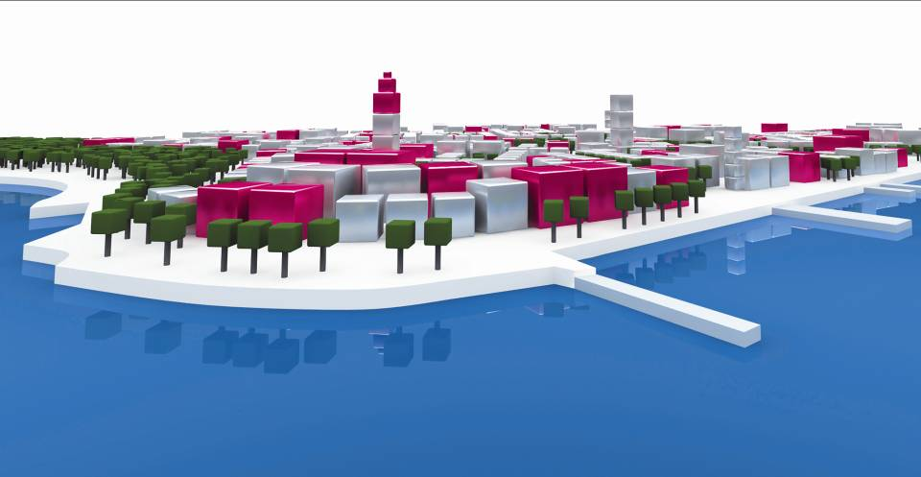
T-City : The Future, Today. How to Create Values with Smart Energy Solutions for a City.
Initial Phase: Smart Metering & Home
Current Phase: Smart Grids
Smart city project in Friedrichshafen (Lake Constance, approx. 60k inhabitants)
Automated meter reading 3,000 metering points
Multi-energy (electr., gas, water)
Use of residential IP infrastructure
Consumer portals
300 user with Smart Home Applications
Home management network
Joint evaluation of potential synergies and economic parameters for Retailer and DSO
Integration of Decentralized power generation
Virtual power plant
Demand side management
Energy storage
E-Mobility

Slide 8
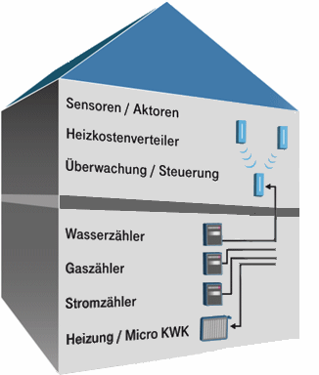




Smart Metering for Multi-Utility.
Our USPs
Multi-Utility Approach
Complex Inhouse Communication
Platform provides unmatched End2End data security and privacy
Proven mass data handling capabilities
Market leader in interoperability (>90 different types of meters from >20 vendors)
Shortest latencies
Remote Software updates
Decentralized data storage (Service Gateway)
Actors / Sensors
Heat Cost allocator
Remote /Control
Water
Gas
Service-Gateway
(MUS)
MDS
IP-Network
MDM-System
Electricity
Heat/Micro CHP
DT‘s Smart Metering Platform
Network Operator
29.03.2012
8
8
Notes:
16.04.2009
8
Autor / Thema der Präsentation
25.08.201016.04.2009

