Slide 1
Patrick Van Hove
DG Research & Innovation
Smart Grids European RD&D
Trends in power industry in the European context
Spindleruv Mlyn, CZ, 18-19/4/12

Slide 2
Outline
Drivers
Smart Grids R&D support
Policies
Future opportunities for support

Slide 3
Electricity grids: Policy drivers
Energy – Climate objectives 2020
  20% renewable energy, up to 35% renewable electricity:
  large hydro, wind; small PV, wind, hydro, biomass, etc.
  20% efficiency improvement. For electricity: efficiency of generation, connection and use of electricity. CHP, reduced grid losses, smart consumption, new uses (electric vehicles, smart cities, etc.)
  20% CO₂ reduction
Security of supply
  Reduce energy dependency, develop both concentrated and distributed generation
  Increase grid robustness
Competitiveness
  Completion of a European market for electricity, mitigate prices
  Enable new services, new market opportunities

Slide 4
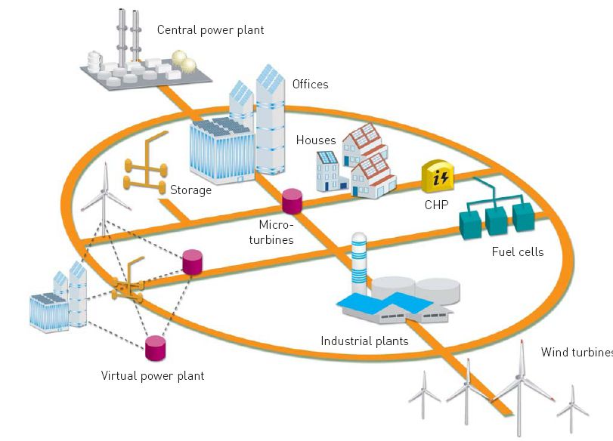
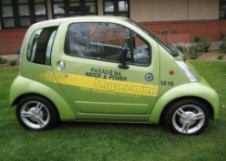

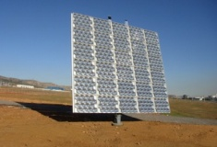
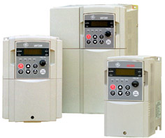
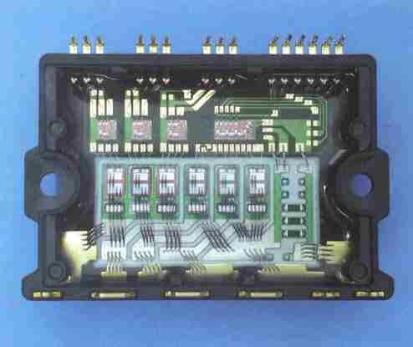
Smart Grids: an agreed solution
A Smart Grid is an electricity network that can cost efficiently integrate the behaviour and actions of all users connected to it - generators, consumers and those that do both – in order to ensure efficient, sustainable power system with low losses and high levels of quality and security of supply and safety.
Seamless integration
of new applications
End user real time
Information &
participation
Central & dispersed
sources
Central & distributed
intelligence
Smart materials and power
electronics
Multi-directional ‘flows’

Slide 5
EU actions for development & deployment of smart grids
Technology push
  SET Plan European Electricity Grids Initiative – EEGI 6/2010
  Projects in R&D Framework programmes. Total support ±400M€
  European Energy Research Alliance EERA – Smart Grids JP 6/2010
  European Technology Platform (New R&D Agenda 2035)
Market pull
  Market regulation: 3rd Internal Energy Market package 8/2009
  Communication on smart grids 4/2011
  Revision of Energy Services directive (proposal 6/2011)
  European Infrastructure package (proposal 10/2011)
  Connecting Europe Facility (proposal 10/2011)
  Recommendation on smart metering systems 3/2012
International cooperation
  International Smart Grids Action Network - ISGAN
Not legally binding

Slide 6
Strategic Energy Technologies Plan
Energy – Climate objectives require new technology answers
  Accelerate development and deployment of low-carbon technologies
  Joint initiatives European Commission – EU Member States
European Industrial Initiatives: public-private partnerships
  Electricity grids, Wind, Solar, Carbon capture and storage,
  Bio-energy, Nuclear, Smart cities, Hydrogen & fuel cells
European Energy Research Alliance (EERA)
  Electricity grids, Wind, Solar- PV & CSP, Carbon capture
  and storage, Biofuels, Marine energy, Geothermal, Materials for nuclear
SETIS: SET Plan Information System

Slide 7
Smart Grids Research & Innovation agendas
SET Plan European Electricity Grids Initiative (EEGI)
  First priority is the 2020 perspective – system integration
  Networks are in the lead – they need to implement the solutions
SET Plan European energy Research Alliance (EERA)
  Joint Programme smart grids: preparing the EEGI after 2020
  European energy research laboratories in the lead
Strategic Agenda 2035 (Smartgrids platform):
  Network-oriented research – medium and longer term
  Technology research – network, storage
  Customer service research
  Agenda to be implemented by other initiatives

Slide 8
European Electricity Grids Initiative:
SET Plan EEGI
External Drivers in 2020 perspective are to
demonstrate and validate the technologies to:
  Integrate 30-35% of variable renewable electricity
  Co-ordinate planning and operation of the pan-European network
  Guarantee a high-level of reliability
  Improve energy efficiency of the overall electricity supply system
  Engage users in efficiency and active demand

Slide 9
EEGI Team: planning and programming
European Commission: Chair: Wiktor Raldow (Dg RTD),
other services represented
Representatives of Public Authorities: 22 Countries so far
  AT, BE, CH, CZ, DE, DK, ES, FI, FR, GR, IT,
  LT, LV, NL, NO, PL, PT, RO, SI, SE, TR, UK
Representatives of TSO’s (and ENTSO-E): 4 and alternates
  ELIA, TENNET, RTE, REE,
  ENERGINET, AMPRION, TERNA, ENTSOE
Representatives of DSO’s (and associations): 4 and alternates
  ENEL, ERDF, IBERDROLA, LINZ STROM,
  FORTUM, EDSO, EDP, CEZ
Other industries and Smart Grids Platform: 4 and alternates
  T&D Europe, Digital Europe, ESMIG, EURELECTRIC

Slide 10
EEGI Emphasis on system integration
Unlocking smart grids deployment in 2020 perspective
  Many technology blocks available, demonstrated in pilots
  Innovation in system integration
  Large scale demonstration to reduce risks of technology deployment
  Business cases, replication and scaling up
  Knowledge sharing
Costs
Risks
Roll-out
Demonstration
R&D

Slide 11
EEGI actors and roles
Level 5: Smart Customers
Customers
Level 4: Smart Energy Management
ESCOs
Retailers
Aggregators
Level 3: Smart Integration
SMART GRIDS
Functional level
Distribution
Network
Level 2: Smart distribution network and processes
Level 1: Smart Pan-European Transmission network
Transmission
Network
Level 0: New generation technologies
Electricity
generation
From EEGI

Slide 12
European R&D support to grids: 2007-2011
Transmission:
  PEGASE, ICOEUR, UMBRELLA, ITESLA: Management, control
  and coordination of pan-European transmission network
  TWENTIES: Demonstration and validation of new technologies
  REALISEGRID, SUSPLAN: Coordinated grid planning
  OPTIMATE: Market models and architectures
  (in negotiation): Demonstrations of grid-scale storage
Distribution:
  ADDRESS: Activate demand
  ECOGRID-EU, GRID4EU: Large smart grids demonstrations
  MERGE, G4V: Impact of electric vehicles
  OPEN METER, DERLAB (FP6): Standardisation

Slide 13
European R&D support to grids: 2007-2011
ICT infrastructure:
  INTEGRIS, DLCVIT4IP, MIRABEL , W2E, HIPERDNO, OPENNODE:
  Telecommunications, secondary substations, high-performance computing
Security:
  AFTER, SESAME, EURACOM, ESCORTS, NI2S3:
  Security of electricity supply against malicious and accidental threats
Support:
  GRID+: Cooperation and networking of demonstration projects

Slide 14
European R&D support to grids: 2012-2013
Transmission:
  (in WP2012): Planning for future European electricity highways
  Topics for WP2013 (tentative): reliability, capacity allocation,
  interconnection technology demonstration, public acceptance
Distribution:
  METER-ON: Sharing best practice in smart metering
  (in WP2012): Families of projects for DER integration,
  distributed intelligence, smart customers
  Topics for WP2013 (tentative): Tools for DSO, integration of electric vehicles
Integrated Research Programmes smart grids, storage: WP2013 (tentative)
ICT support to smart grids:
  (in WP2012): Decision support tools, metering infrastructure, power electronics, home systems, standardisation
  Topics for WP2013 (tentative): Telecommunication infrastructure
  for smart grids
EC support for electricity grids ± 400M€ (FP7: 2007 – 2013)

Slide 15
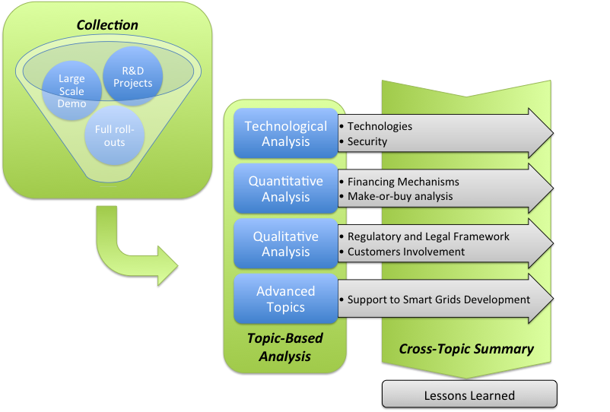
Meter-ON
Supporting the implementation of smart metering solutions
collecting the most successful experiences in the field to draw lessons learned and
highlight the conditions that enabled their development
On-going negotiation, project start expected 1 May

Slide 16
Smart electricity grids: recent EU Policies
3rd Internal Energy Market Package
  Consumer choice of electricity supplier, relevant consumption data;
  Unbundling of transmission & generation, 3rd party access; responsibilities of transmission & distribution network operators;
  Independence of regulators, ACER
  Deployment of smart metering systems
Communication on smart grids
Recommendation on roll-out of smart metering systems
  Data protection, methodology for economic assessment, minimum functional requirements for smart meters for electricity
Energy Services Directive (proposal)
Standardisation M/441, M/468, M/490 CEN, CENELEC, ETSI
Infrastructure package, Connecting Europe (proposals)

Slide 17


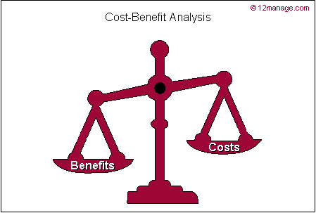



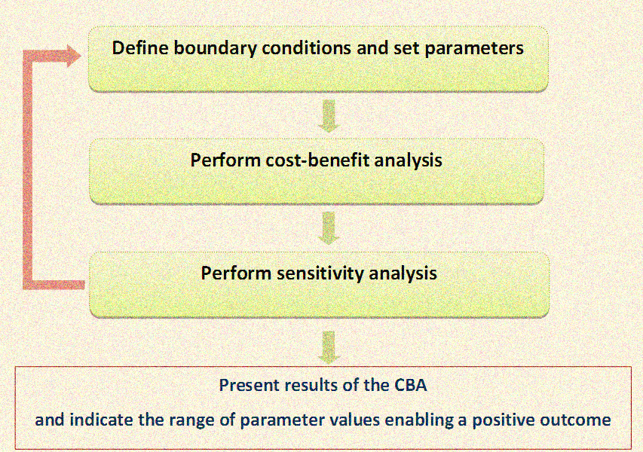
Overall appraisal for the roll-out of Smart Metering
Economic appraisal
(Societal CBA)
Non-monetary appraisal
(Qualitative impact analysis)
Merit deployment of the roll-out (contribution to policy goals)
KPI analysis
CBA Externalities
(e.g. employment, safety, environmental impacts)
Qualitative descriptions/physical units

Slide 18
Infrastructure package, SG task force
“Priority corridors”
  4 electricity interconnection priorities
  4 gas interconnection priorities
  Others: central Europe oil corridor, smart grids, electricity highways, cross-border CO₂ network
Identification of Projects of Common Interest for smart grids:
  Process being tested in 2012, Expert Group 4 of Task Force
  Projects of common interest for energy – for telecommunications
Projects of Common interest for smart grids/energy:
  10 kV and higher, TSO and DSO from at least 2 member states
  ≥ 100,000 users involved, ≥ 300GWh/year, at least 20% from non-dispatchable sources

Slide 19
Future opportunities for support
FP7 – Work programme 2013
  Energy - Electricity grids
  Energy - Smart cities and communities
  ICT for a low carbon economy
Horizon 2020
  EC proposal end 2011, expected launch 2014
Infrastructure package – Connecting Europe Facility
Regional funds

Slide 20
Horizon 2020:
  Commission proposal for a 80 billion euro research and innovation funding programme (2014-2020)
  A core part of Europe 2020 Strategy, Innovation Union flagship initiative & European Research Area:
    - Responding to the economic crisis to invest in future jobs and growth
    - Addressing people’s concerns about their livelihoods, safety and environment
    - Strengthening the EU’s global position in research, innovation and technology and competitiveness of the European industry

Slide 21
What’s new:
*The 7th Research Framework Programme (FP7), innovation aspects of
Competitiveness and Innovation Framework Programme (CIP),
EU contribution to the European Institute of Innovation and Technology (EIT)
  A single programme bringing together three separate programmes/initiatives*
  Coupling research to innovation – from research to market introduction, all forms of innovation
  Focus on societal challenges facing EU society, e.g. clean energy, health and transport
  Simplified access, for all companies, universities, institutes in all EU countries and beyond.

Slide 22
Three pillars:
Excellent science (ERC, FET, MarieCurie, Infrastructures):
Identification and development of new cutting edge technologies and materials
Industrial leadership (SMEs, ICT, Materials):
Innovative and efficient solutions to the technical challenges, including proprietary technologies, allowing European industry to stay in a global competitive and leading position
Societal challenges:
Broader look at the technological and societal challenges striving for a multi-disciplinary innovative solution allowing Europe to become smart and sustainable

Slide 23
Key challenges proposed funding:
(million euro, 2014-2020)
Health, demographic change and wellbeing | 8 033
Food security, sustainable agriculture, marine and maritime research & the bioeconomy | 4 152
Secure, clean and efficient energy* | 5 782
Smart, green and integrated transport | 6 802
Climate action, resource efficiency and raw materials | 3 160
Inclusive, innovative and secure societies | 3 819
*Additional €1 788m for nuclear safety and security from the Euratom Treaty
activities (2014-2018). Does not include ITER.

Slide 24
Key challenges proposed funding:
(million euro, 2014-2020)
Health, demographic change and wellbeing | 8 033
Food security, sustainable agriculture, marine and maritime research & the bioeconomy | 4 152
Secure, clean and efficient energy* | 5 782
Smart, green and integrated transport | 6 802
Climate action, resource efficiency and raw materials | 3 160
Inclusive, innovative and secure societies | 3 819
Renewable sources
Electrical vehicles
Low environmental impact
Cyber security
*Additional €1 788m for nuclear safety and security from the Euratom Treaty
activities (2014-2018). Does not include ITER.
Notes:
24
Slide 7 (Key Challenges proposed funding)
• Out of the 6 challenges proposed, 4 are related with smart grids and we do expect the smart grids stakeholders to collaborate in reserach and innovation to address them.

Slide 25
Energy challenge activities:
(1) Reducing energy consumption and carbon footprint by smart and sustainable use;
(2) Low-cost, low-carbon electricity supply;
(3) Alternative fuels and mobile energy sources;
(4) A single, smart European electricity grid;
(5) New knowledge and technologies;
(6) Robust decision making and public engagement;
(7) Market uptake of energy innovation.
Notes:
25
Slide 8 (Energy challenge activities)
The broad line of research and innovation activies on secure, clean and efficient energy which will be supported under Horizon 2020 spans from carbon footprint reduction of existing technolgies, for example via carbon capure storage technologies to be coupled with fossil fuel usage, to the development of new low carbon technologies, such as alternative fuels and mobile energy sources.
The research and innovation activities will also address non technological barriers such as decision making processes and development of appropriate business models to allow market development of the energy innovation.

Slide 26
Energy challenge activities:
(1) Reducing energy consumption and carbon footprint by smart and sustainable use;
(2) Low-cost, low-carbon electricity supply;
(3) Alternative fuels and mobile energy sources;
(4) A single, smart European electricity grid;
(5) New knowledge and technologies;
(6) Robust decision making and public engagement;
(7) Market uptake of energy innovation.
demand side management
RES integration
pan-European grid integration
technology development
market deployment of smart grids
Notes:
26
Slide 9 (Energy challenge activities)
Electricity grid activities have a central role to achieve a secure, clean and efficient energy and the achievement of a single and smart pan European electricity grid which will be pivotal to deliver the European single interconnected electricity market.
The grid community can and should contribute to many of the energy challenge activities for example addressing energy consumption with demand side management reserach, allowing increase in low carbon supply via integration of renewable energy sources, developing new technologies and knowledge which will continue to make Europe competitive on a worldwide scale, supporting further the validation and demonstration of the advanced grids technologies and their market development.

Slide 27
Thank you
Patrick.Van-Hove@ec.europa.eu
http://ec.europa.eu/research/energy/index_en.cfm
http://www.smartgrids.eu/
http://www.gridplus.eu/
http://ec.europa.eu/energy/gas_electricity/smartgrids/smartgrids_en.htm

