Slide 1
AMM Drivers in Italy or “Why to become smart”
Ilario Tito & Laura Panella
Europe and Americas Business Development
Infrastructure and Network Division
Spindleruv Mlyn, 18th April 2012
Notes:
1
Good afternoon…
My name is…
I work in Enel Distribuzione, in the International Business Development Office within Infrastructure and Network Division
I am proud to be here to represent Enel, a global energy company, whose development is driven by innovation.

Slide 2
Outline
Enel Group Smart Metering Experience
Main Drivers of Enel Cost / Benefit Analysis
Unpredicted Benefits
Notes:
2
Let me present you the topics I am going to deal with this afternoon.
First of all I’d like to briefly introduce you my company, countries where it operates, focusing on energy distribution and network management, main improvements introduced within last decades and their deep impact on efficiency and on customers.
After a small, important description about what smart grid is intended to be in Europe and America, I’d like to show you Enel accomplishments about smart metering deployment, the first milestone towards operating in a smarter a power grid.
I will conclude my speech showing you how enel is continuing its path towards a smarter way of operating the grid

Slide 3

Uso:
pubblico
Enel Network Management and Innovation
Heading towards efficiency, the Enel experience as DSO world reference
> 2.000 HV/MV substations remotely controlled (100%)
> 100.000 MV/LV substations remotely controlled (more than 25%)
Improved Neutral Grounding System
Automatic fault clearing
procedures on 65% of
MV Lines
Satellite mapping of network assets
Database of network events (power outage notification, fault detection)
Optimization of network investments based on a risk analysis
Optimization of network maintenance
Smart Grid/
Network
Automation
Asset
Management
Process
reengineering
37 mln meters in Italy
13 mln new generation meters being deployed in Spain
340 Mln/ year remote readings
15 mln/ year remote operations
97,4% operations correctly performed (2010)
5.200 Enel teams connected via GPRS with GPS localization
ENEL cartographic on board
Mobile applications for all Field Operations
Automatic
Meter
Solutions
Work Force
Management
State-of-the-art technologies and process optimization to deliver value to our stakeholders and partners
6

Slide 4
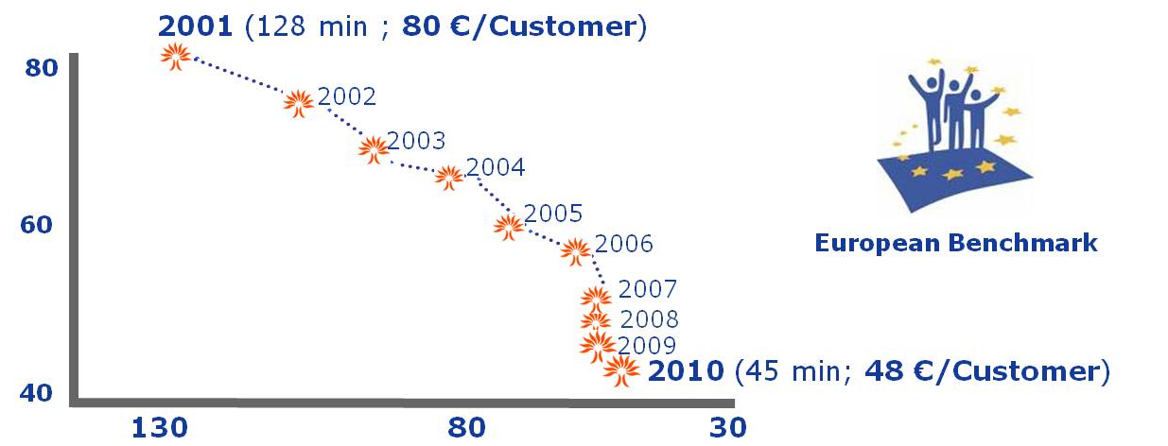
Enel Operational Excellence: the Italian case
A 10 year path towards becoming the European benchmark
Uso:
Uso:
pubblico
pubblico
Opex
(€/customer)
Smart Grid/
Network Automation
Asset Management
Process Reengineering
Smart Metering
Work Force
Management
Quality of service
(minutes interruption/year)
      Opex reduction: - 40 %
      Quality of service: +68 %

Slide 5
Outline
Enel Group Smart Metering Experience
Main Drivers of Enel Cost / Benefit Analysis
Unpredicted Benefits
Notes:
5
Let me present you the topics I am going to deal with this afternoon.
First of all I’d like to briefly introduce you my company, countries where it operates, focusing on energy distribution and network management, main improvements introduced within last decades and their deep impact on efficiency and on customers.
After a small, important description about what smart grid is intended to be in Europe and America, I’d like to show you Enel accomplishments about smart metering deployment, the first milestone towards operating in a smarter a power grid.
I will conclude my speech showing you how enel is continuing its path towards a smarter way of operating the grid

Slide 6
Smart Metering Deployment
Key success factors
Massive roll out
all Enel’s LV customers in parallel/ uniform lots in order to anticipate savings
20% yearly substitution
Speed of implementation
International procurement
global OEM manufacturing + Enel onsite teams for production planning&control to ensure high volumes of production / high quality
Value creation
International standards
open technologies and solutions
Crossover technologies
Mesh for SM + mobile communication for concentrators
Strong communication effort
Customer engagement
Continuous innovation
implementation of the most up to date solutions

Slide 7
Smart Meter Project Cost Benefit Analysis
Project’s key indicators
Number of Meters installed 33 Mln units
  Monophase 90%
  Poliphase 10%
100% advanced new-generation meters
Roll-out 5 Years
Cumulated CAPEX* 2,1 Bln €
Yearly Running Costs ** 67,3 Mln €
Yearly Savings ** 450 Mln €
Meter Average Life 15 years
PBP
5 years
* Capex for 31 Mln meters by 2006; Concentrator/ meter @ 1/80
** at the end of roll-out period
7

Slide 8
Costs - Investment
Breakdown per point of delivery
73%
20%
7%
Smart Meters and Data Concentrators
Installation
System
Technology (field + system) → approx. 80% of S.Metering CAPEX

Slide 9
Average non-discounted data
Smart Meter Project Cost Benefit Analysis Costs and Investment Estimate
Smart meter
Concentrator/ TLC
PM/HW/
SW
Total costs
Drivers
Capex assume: single phase-polyphase Smart Meter + installation;
Opex include: metering, account admin., invoicing, personnel for metering superv.*
Investment costs assume: concentrator + installation.
Operation costs include data transfer of data through PLC, communication to the concentrator
Capex include: AMM customizing, interfaces with legacy,servers + Project Management costs;
Variable costs include hardware+software maintenance
Investment
(€/SM)
~ 68
~ 2,2
Yearly operation costs
(€/SM)
* Operation costs due to remote reading failure and meter failure taken into account as reduction of savings

Slide 10
Impact on Business
Yearly savings and quality of service
Low savings
High savings
  Field Operations and Logistics:
  Manual Meter replacement due to failure reduced by 70% with respect to dynamic meters
  Contract parameter modification reduced by 95%*, Quality parameter Deadline greatly improved, reaching 99,7% by end of deployment
  Manual activation and deactivation reduced by 99%
  On-field readings reduced by 99%
  Logistic costs reduced by 80% due to standardization of models (only three)
  Energy Losses:
  Energy balance for each transformer and antitamper signals allow for a more accurate fraud contrast, increasing success rate by up to 70%
  Credit Control and Management:
  Remote deactivation of bad payers prohibits customers from continuing illicit consumption and increasing their own debt
  Monthly readings improve correctness of energy balance and optimize cash flows
*Only modification for single-poly phase switching and system failure (less than 2%)
Strong operating benefit delivering
Savings approx.15 € per point of delivery and 2€ yearly opex per p.o.d.

Slide 11
Included in model
Not included in model
Smart Meter Project Cost Benefit Analysis Yearly savings (end-of-installation)
Decrease of Operation costs*
Purchasing & Logistics
Lower Energy Losses
Customer Service, Billing
Drivers
Meter reading
Remote connection/ disconnection
Avoided meter replacement (no meter change for contractual changes, lower meter failure)
Lower switching costs
Avoided dispatch to false failure
Lower metering maintenance + recalibration costs
Lower fraud verification costs
  ~10
  Lower purchasing cost, warehousing cost, meter overhauling logistic..
  ~ 2
  Revenue Protection/ lower commercial losses: lower losses for tampering/ fraud, thefts and reading errors
  Lower meter energy consumption (technical losses)
  ~ 2
New tariffs/better pricing methodology
Improved customer profiling and load administration
Receivables optimization
More precise billing and lower customer service-related costs
Lower back-office activities for errors/ litigations
~ 1
Estimated yearly
Savings
(€/SM/year)
* Do not include smart grid benefit (i.e.: faster outage identification, lower network losses, because it may require network technology upgrade)

Slide 12
Smart Meter Project Cost Benefit Analysis NPV of a Central Europe 2 Mln customers utility
21%
100%
40%
53%
26%
10%
17%
3%
14%
36%
34%
14%
Savings from operations
Logistic/ purchas. gains
Energy Losses
Cust. Service & Billing
Savings
Meter/ concentr.
Install. costs
HW/ SW/ PM costs
Total capex
Total opex
NPV @100% of savings
IRR
16%
NPV
@80% of savings
IRR
11%
… enough to become Smart?

Slide 13
Outline
Enel Group Smart Metering Experience
Main Drivers of Enel Cost / Benefit Analysis
Unpredicted Benefits
Notes:
13
Let me present you the topics I am going to deal with this afternoon.
First of all I’d like to briefly introduce you my company, countries where it operates, focusing on energy distribution and network management, main improvements introduced within last decades and their deep impact on efficiency and on customers.
After a small, important description about what smart grid is intended to be in Europe and America, I’d like to show you Enel accomplishments about smart metering deployment, the first milestone towards operating in a smarter a power grid.
I will conclude my speech showing you how enel is continuing its path towards a smarter way of operating the grid

Slide 14
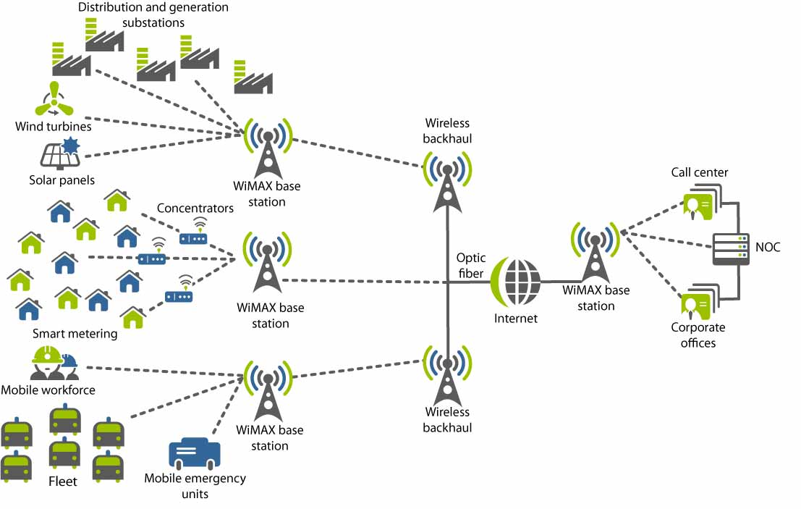
Effective Billing & Trader Switching
Heading towards greater operational efficiency
Automated Billing
Readings
Free Market
Billing
95% of bills dispatched within the first 8 days of each month
Strong improvement of credit indicators
Billing is not estimated, making invoices reliable and true to authentic levels of consumption
7 mil. clients handled
System capacity of >1 mil customers/day
Regulated Market
Billing
Readings
25 mil. clients handled
Trader Switching
~270k Monthly operations
99,9 % Carried out in the first week of following month
Regulatory framework allows customers to freely chose retailer, while real time Trader switching allows for a greater perception of benefits.
In an increasingly open market, the number of operations is bound to grow. Becoming Smart is vital to stay in business
Notes:
14
14
Let me introduce you

Slide 15
THANK YOU FOR YOUR ATTENTION
ilario.tito@enel.com
laura.panella@enel.com
International Business Development
Infrastructures and Networks Division
Enel Distribuzione Spa
Via Ombrone,2
00198 ROMA
Notes:
15
On behalf of my company, let me thank you very much for your invitation and for the interest in knowing more about Enel projects.
I apologize for this very long speech but, as you have seen, Enel is very committed in this field as well as in Smart Grids deployment.
I hope the presentation was interesting for you and of course I’m here also to clarify any doubts and to give you other information you may need.
Thank you again.

