Slide 1
Smartness does not come from meters…
Baard Eilertsen
CEO Maingate

Slide 2
…it comes from how you use the data!

Slide 3
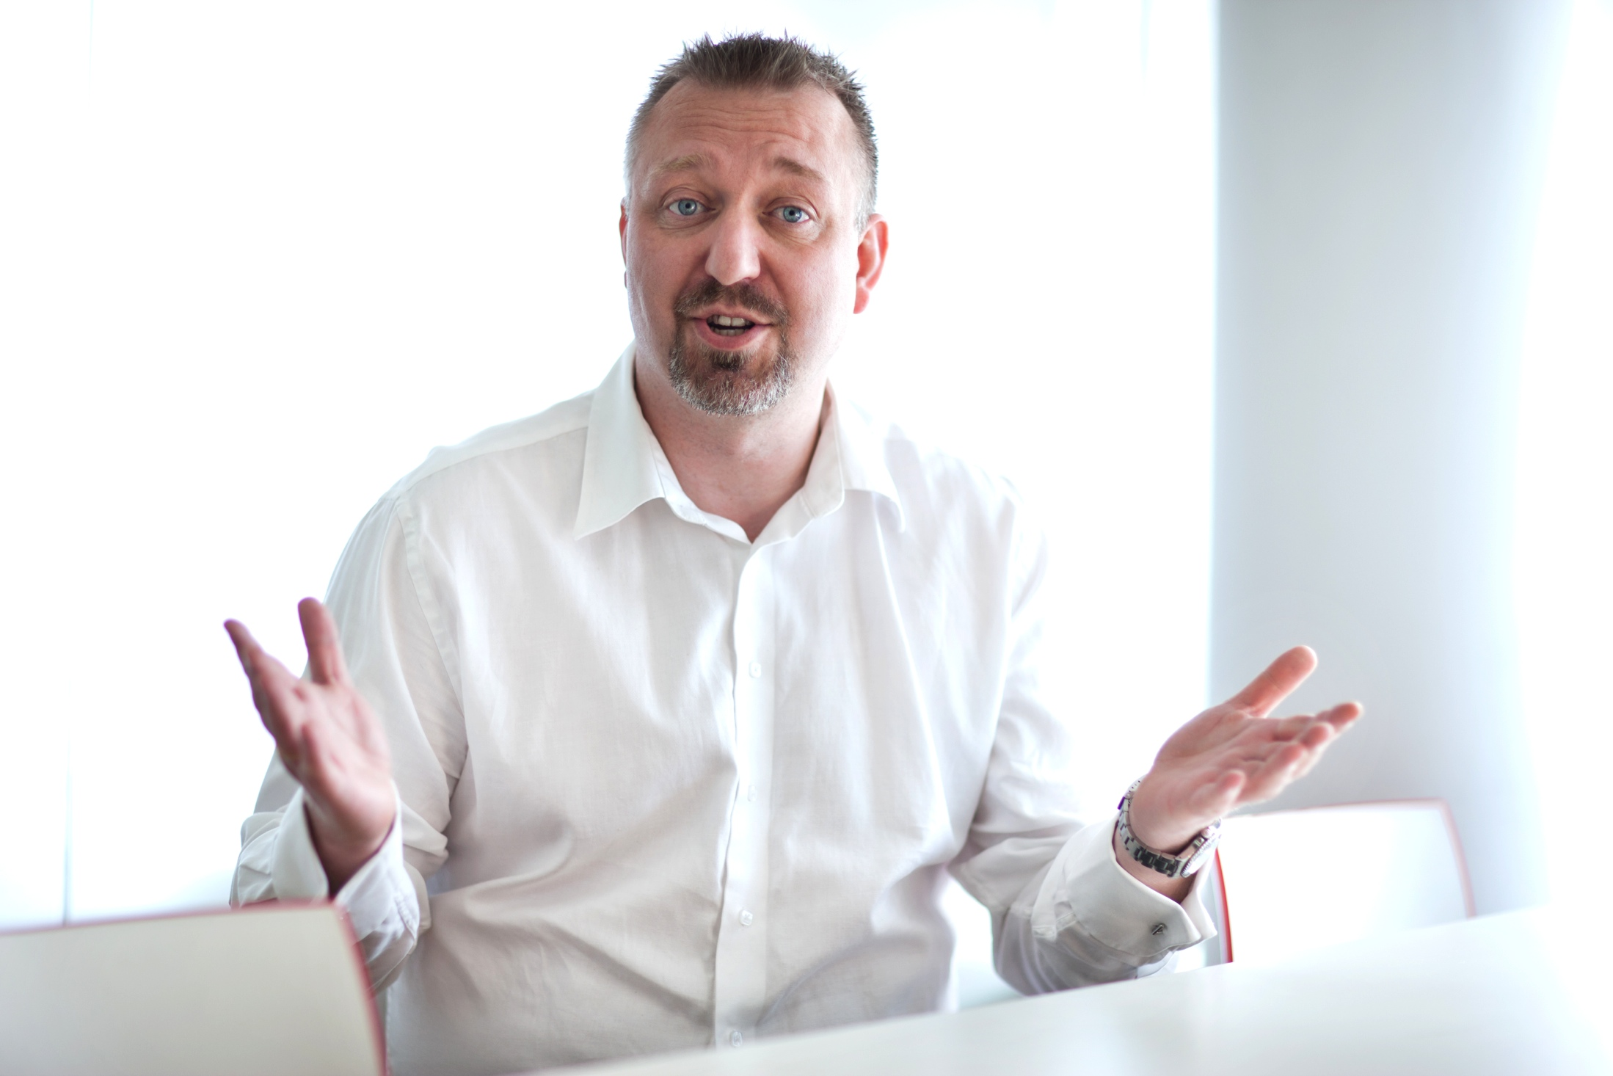

”Without a human perspective on M2M technology we will never experience the full potential of M2M.”
“When the infrastructure is in place there are no boundaries of how it can be utilized. Both at home and at work.”
“We now talk about M2H, machines servicing human and not at least machines servicing society in large.”
Baard Eilertsen, CEO at Maingate
Notes:
http://it24.idg.se/2.2275/1.295255/maskiner-ar-dina-nya-kunder

Slide 4
EU 20-20-20
Increase investments in
Renewable energy source
20% renewable
-11,3% in 2010
compared to 1990
20% reduction of carbon emission
Slow roll out of Smart
Meters and only done from
a technology perspective
(M441)
20% energy efficiency

Slide 5
Swedish study
All Swedish meters are “smart” from September 2009
Consumption of energy has risen with 25% in the last 10 years
At the same time the yearly average price of a kWh has gone up with 229%
Smart Metering has increased the easiness of switching
Smart Metering has improved the knowledge of consumers and have increased the awareness
Smart Meters have, however, not created efficiency as expected

Slide 6
New thinking is needed…

Slide 7
What do these have in common?

Slide 8
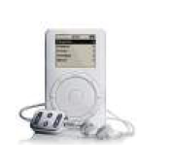


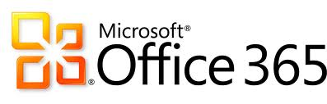
Obsolete apps replaced by digital one´s and then turned into services

Slide 9
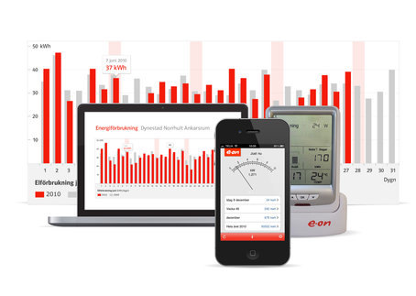
And the electrical meter have gone from products to Value added services online

Slide 10
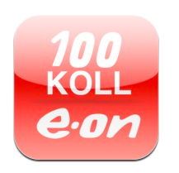
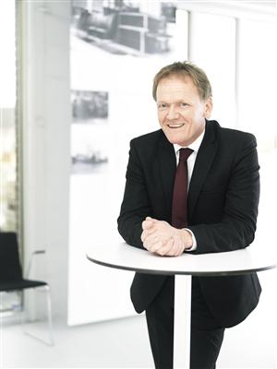
E.ON give its customers 100KOLL
Through innovative technology the customers of the energy company E.ON are able to control their energy consumption via smart phones. It is only when you are both aware and have access to real knowledge about your energy consumption that you can make active decisions and lower both your cost and impact on the environment, says Anders Olsson, Deputy CEO at E.ON.

Slide 11
Thank you!

Slide 12
Baard Eilertsen
8 Years within Oil & Gas industry
  Upstream technology
  Offshore installations
12 Years within TietoEnator
  Head of AMR/AMM unit
    2 projects delivered as prime
    ”Thought leader” for Smart Metering in Europe
    Support to C-level management within Large European utilities in issues regarding Smart metering
4 Years as CEO & President of Wireless Maingate AB
  Supporting EU in regulatory issues and thoughts around Smart metering/Grid
  Works closely with large utilities as advisor for renewed digital strategies and consumer orientation

Slide 13

Maingate Facts
Founded in 1998
Started as a M2M MVNO focusing on industrial applications and a B2B professional messaging service provider
Today a Service Operator focusing on the complete M2M value chain, including M2H – Machine to Human
Nordic market leader
Customers worldwide
More than 1500 customer references

