Slide 1
Sustainable Supply Chain Workshop
Notice:
This workshop, organized by the CEZ Group, is not intended to serve as a platform for participants to discuss business interests; it will be used solely to provide general instructions and information to help the surveyed companies complete the individual questions in the questionnaire designed by the organizer in compliance with competition law.

Slide 2




Today’s workshop organizers and presenters
Tereza
Kujaníková
Marie-Anna Bitnerová
Jiří
Harák
Eva
Holková
Sustainable Supply Chain Manager
Supply Chain Specialist
Supply Chain Specialist
HR Development Specialist

Slide 3






WORKSHOP AGENDA
    Why do we collect ESG data from suppliers?
    What does the questionnaire cover?
    What are the activities of the Sustainable Supply Chain Department?
    What are the benefits of completing the ESG questionnaire, and where can you find more information?

Slide 4
Why do we collect ESG data from suppliers?
Three reasons, one goal:
responsible and resilient long-term supplier relationships.
1.
Reporting and transparency
3.
2.
VISION 2030
Risks and due diligence
Information from the value chain forms part of CEZ Group sustainability reporting under European sustainability standards.
The data helps CEZ Group meet its sustainability reporting requirements.
The data helps identify issues related to human rights, the environment, ethics, and risk management in the supply chain.
CEZ Group has committed to taking action to promote ESG criteria in the supply chain.
We use the information provided solely for CEZ Group purposes.
Only aggregated information and overall conclusions may be published externally.

Slide 5



What framework do we follow?
European sustainability reporting requirements (CSRD and ESRS)
Due diligence requirements in the value chain (CSDDD, the Corporate Sustainability Due Diligence Directive)
Related Czech legislation (the Accounting Act and the Capital Market Undertakings Act)

Slide 6

Which suppliers do we contact, and why?
We do not send the ESG questionnaire to every supplier. The selection is targeted.*
Financial significance
Value of direct supplies to selected CEZ Group companies.
If you have received the questionnaire, your company is part of the selected group for this period.
We therefore ask for your cooperation and for complete, accurate answers.
Type and nature of the supply
Type of supply and nature of the contractual relationship
Selected suppliers
Risk profile and other factors
Country and sector risk, together with CEZ Group’s internal assessments.
The selection is based on a combined assessment of these factors.
*Receiving the questionnaire does not in itself mean that a supplier is considered high-risk.

Slide 7




What does the questionnaire cover?
The questionnaire is designed to collect information. The results are assessed in the context of supplier risks and related analyses.
Reporting and due diligence
E | Environment
S | Social
G | Governance
Reports, policies, ESG ratings, and due diligence processes
Emissions, energy, waste, biodiversity, and environmental risks
Human rights, working conditions, occupational health and safety, and equal opportunities
Ethics, compliance, risk management, and transparency
Attachments and comments help us assess your answers correctly.
If supporting documents are unavailable, please describe the current situation accurately.
Do not create a substitute document solely for the questionnaire.

Slide 8




New topics in the 2026 ESG questionnaire
In 2026, the ESG questionnaire was revised
July 2026
The goal was to update the ESG questionnaire in accordance with current legislative and reporting requirements
The review process was conducted internally with the participation of the relevant company departments
New topics in the ESG questionnaire
Company’s net turnover
Significant ESG incidents, including a description of the incident and the measures taken, where applicable
Representation of women in the highest governing body
PFAS (chemicals)
Work-related injuries, including fatalities, and work-related illnesses

Slide 9
How have we progressed since 2024?
From a common framework to practical support and tailored feedback for suppliers.
2024
2025
2025–2026
2026
Common framework
Supplier engagement
Feedback and support
Integration into management
Sustainable Supply Chain Policy
Pilot data collection: ESG questionnaire and stakeholder dialogue
Q&A sessions and workshops
Risk analysis and follow-up measures
New CEZ Group Vision 2030 target
Feedback for suppliers
Automated ESG questionnaire evaluation and ESG risk analysis
Integration of the questionnaire into SAP Ariba
Full Sustainable Supply Chain website launched
Tailored recommendations and guidance
Process automation, including updates to internal databases containing assessments of activities
Integration of intra-group data
Clear rules and long-term direction
Systematic consideration of supplier feedback
Practical results that support further development
A more systematic approach to data and risks
Outcome:
Today, the ESG questionnaire is more than a data collection tool. It is part of our long-term cooperation with suppliers.

Slide 10
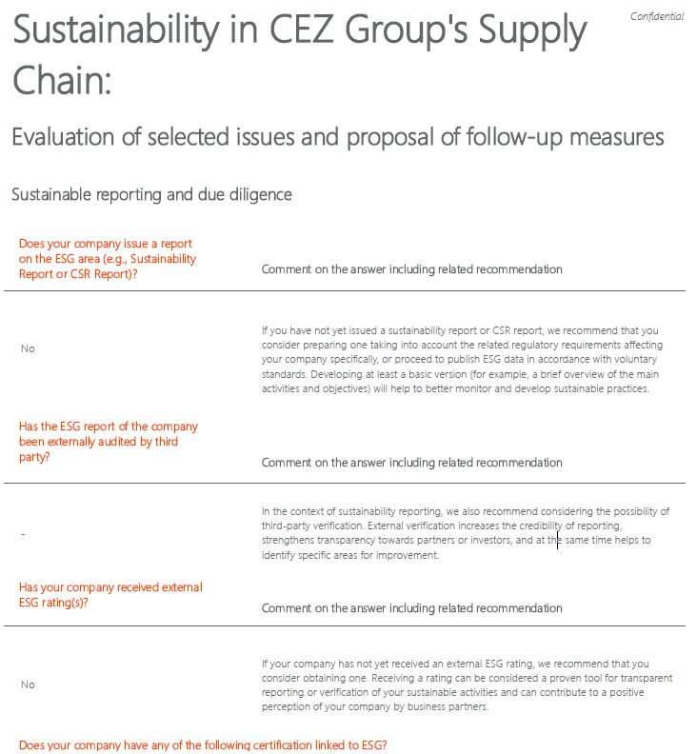
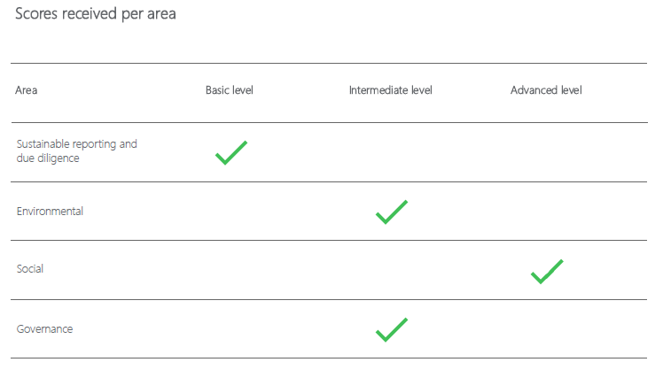
What will you receive after completing the ESG questionnaire?
Tailored feedback for suppliers
After completing the questionnaire, you will receive:
An automated individual supplier assessment across the questionnaire’s four areas
Comments on your answers
Specific, tailored recommendations for key assessment areas

Slide 11
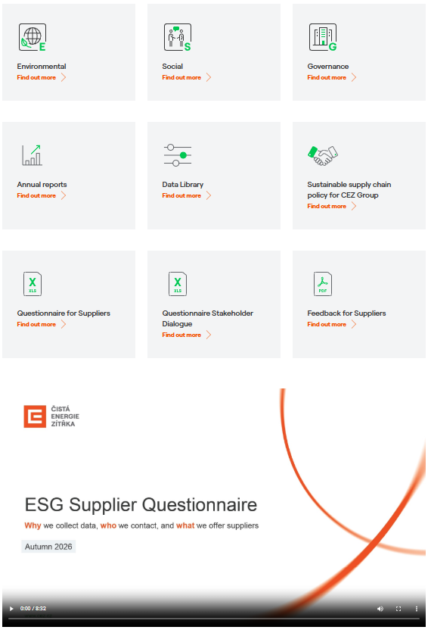
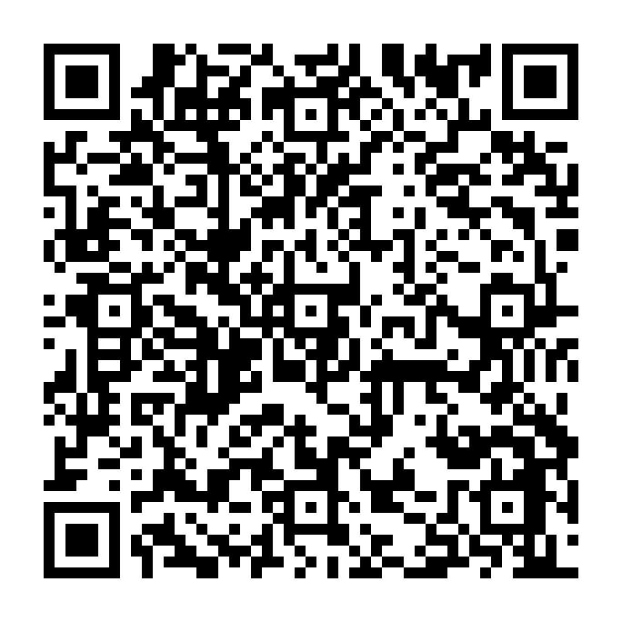
Support for suppliers
You can find related information and answers to frequently asked questions on our website.
Sustainable Supply Chain | CEZ Group
Please also feel free to contact us at any time at supplychain@cez.cz.

Slide 12
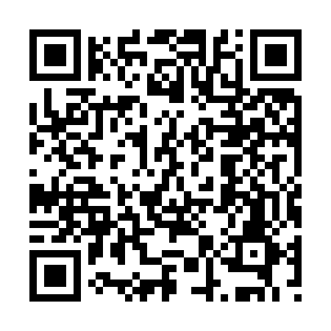
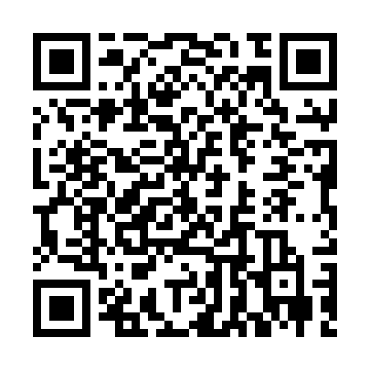



What support is available when completing the ESG questionnaire?
All information, supporting materials, and contact details are available on the CEZ Group websites listed below.
https://www.cez.cz/sustainability/en
https://www.cez.cz/nextcez/en/home
Questionnaire Completion Guides, Q&A
Supplier workshops
Step-by-step guidance, explanations of key terms, and answers to frequently asked questions.
Workshops are offered on several dates to support suppliers in completing the ESG questionnaire.
Email support
Questionnaire available to download in advance
Contact us at supplychain@cez.cz if you have any questions or encounter any difficulties.
The complete questionnaire is available on the website as an Excel file to help you prepare.
How will you receive the questionnaire, and when is it due?
You will receive the questionnaire through the SAP Ariba portal or via a link sent by email (Startquestion). The standard completion period is 30 calendar days from delivery. The accompanying email will specify the deadline and how to access the questionnaire.

Slide 13
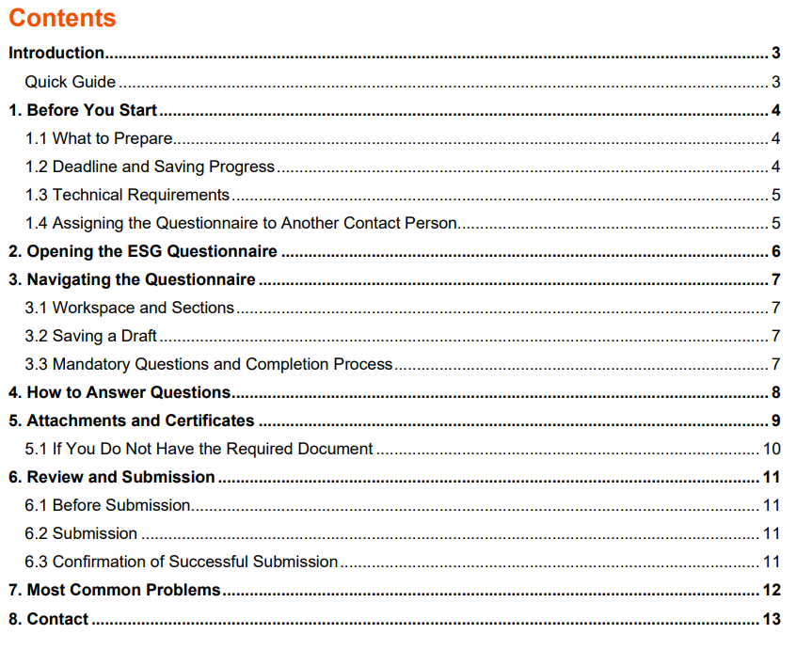
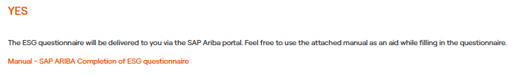
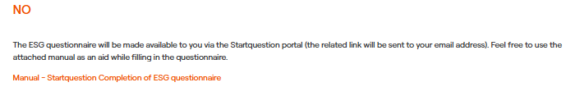

Manuals for completing the ESG questionnaire are available for download
The manuals provide basic instructions for navigating the questionnaires available on the SAP Ariba supplier portal and the Startquestion platform.
Manuals are available for download on the website.
Are you registered as an SKČ supplier on the SAP Ariba portal?
Sustainable supply chain | CEZ Group

Slide 14

THANK YOU FOR YOUR COOPERATION
A carefully completed questionnaire helps us manage risks more effectively and develop responsible supplier relationships. In return, you will receive specific feedback to support your further work on ESG topics.
If you have been contacted, please review the materials on our website and complete the questionnaire by the deadline stated in the email. If you have any questions, please contact us.

Slide 15
Discussion
Notice:
The information you provide in the questionnaire is intended solely for use by the CEZ Group and will not be shared externally. Any publication will be limited exclusively to aggregated data and summary conclusions. The questionnaire survey is for informational purposes only and will have no direct consequences for the duration of specific contractual relationships. We continue to analyze and evaluate the findings from the ESG survey and take the results into account as part of related comprehensive supplier analyses.

Slide 16
Deadline for completion: October 30, 2026
Thank you for your cooperation!

Slide 17

FAQ
How will the provided data be handled?
The information you provide in the questionnaire will be used exclusively for the purposes of the CEZ Group and will not be shared externally. Any potential disclosure will be limited to aggregated data and summary findings only. Following the completion of the ESG questionnaire, you will receive individualized, automated feedback in the coming months. This feedback will offer specific recommendations to help you advance further in your sustainability efforts.
In the event of unfavorable results of the questionnaire survey, are there any negative consequences for me within the existing contractual relationships?
There are no immediate consequences. This is merely an informational survey that does not directly affect the duration of specific contractual relationships. We continue to analyze and evaluate the findings from the ESG survey and take the results into account in our related comprehensive supplier analyses.

Slide 18
FAQ
Is it mandatory to complete the ESG questionnaire?
European sustainability legislation has expanded requirements for the collection, assessment, and disclosure of ESG information across supply chains. Should you be contacted in this regard, we kindly ask for your cooperation. While completion of the questionnaire is voluntary, failure to participate may result in a supplier being automatically classified into a higher-risk category. In line with risk management and due diligence principles, such suppliers may then become subject to follow-up mitigation measures. These measures may include more frequent requests for corrective actions, follow-up audits, risk monitoring through an external tool, and other related actions.
What are the criteria for selecting the addressed suppliers in 2026?
The main selection criteria include the significance of direct supplies to selected CEZ Group companies, assessed in terms of financial volume, scope of supply, and contractual arrangements, while taking related criteria into account. Selected non-EU international suppliers are also included in the assessment.

